Slide 1
Infrastructure as Code
With CDK for AWS
Lloyd Atkinson

Slide 2
Declarative & Consistent Environments via Code
Infrastructure as Code (IaC) is the managing and provisioning of infrastructure through code instead of through manual processes. With IaC, configuration files are created that contain your infrastructure specifications, which makes it easier to edit and distribute configurations.
Infrastructure as code (IaC) uses DevOps methodology and versioning with a descriptive model to define and deploy infrastructure, such as networks, virtual machines, load balancers, and connection topologies. Just as the same source code always generates the same binary, an IaC model generates the same environment every time it deploys.

Slide 3
The problems with manual infrastructure approaches
Human error. It’s easy to create infrastructure with any method; but it’s not easy to consistently produce the same result when running scripts ad-hoc, “one-off” deployments, and natural changes over time.
Lack of consistency. Multiple tools, scripts, tools, and methodologies require more time spend on ensuring correctness and consistency.
Scaling becomes too hard and has limited reproducibility.
Slower feedback loop. Deployment becomes slower, feedback becomes slower, development becomes slower.

Slide 4
Automated, declarative, maintainable infrastructure as code
Infrastructure should not be at risk of becoming fragile, resistant to change, or practically impossible to redeploy
Infrastructure should be able to be version controlled, expressed in written language form, able to be shared, changed, and updated
Infrastructure should be able to be created and destroyed in minutes – not months
Infrastructure should be declared as code and anyone that needs should be able to make infrastructure changes and have it deployed automatically

Slide 5
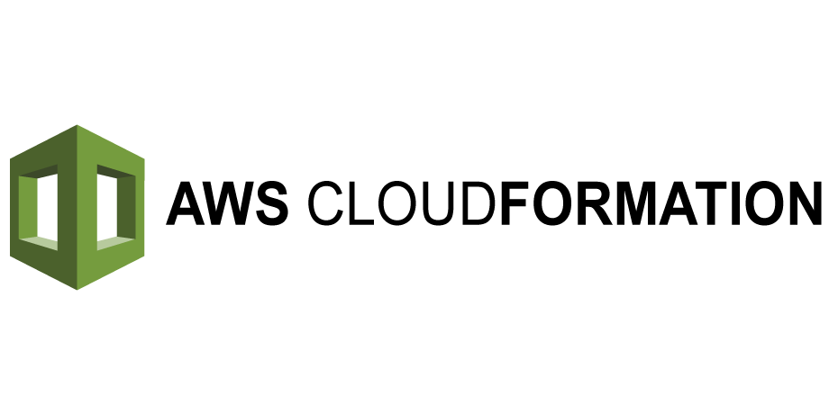
Popular IaC solutions
In general terms there are two broad categories of IaC: imperative and declarative.
Imperative IaC is using existing languages and frameworks to create infrastructure step by step by indicating how the infrastructure should exist
Declarative IaC is using schema-based Domain Specific Languages (DSLs) to indicate what infrastructure must exist

Slide 6
Popular IaC solutions
Popular IaC tools have different design philosophies; imperative vs declarative, DSLs vs existing language, cloud agnostic vs cloud specific, stateful vs stateless
 | Conventions | Declarative | DSL | Cloud Agnostic | Stateless
Nix/NixOS | ✅ | ✅ | ✅ | ✅ | ✅
Terraform | ✅ | ✅ | ✅ | ✅ | ❌
AWS Cloudformation | ✅ | ✅ | ✅ | ❌ | ✅
Azure ARM/Bicep | ✅ | ✅ | ✅ | ❌ | ✅
AWS CDK | ✅ | ❌ | ❌ | ❌ | ❌
Pulumi | ✅ | ❌ | ❌ | ❌ | ❌
PowerShell, Bash, Ansible, Chef, etc | ❌/🤔 | ❌ | ❌ | ❌ | ❌

Slide 7
IaC maturity rank
Rank | Solution
A | Automated CI/CD, fast feedback loops, declarative infrastructure as code, unique environments can be rapidly created with PRs in source control, frequent and low ceremony releases, multiple releases daily if desired, unit testing of IaC
B | Automated CI, some manual processes, releases have a degree of ceremony, infrequent releases, some deployment scripts
C | Deployments involve SSH or RDP with servers and manually deploying files, “big bang” releases every months or quarters, slow feedback loop
D | No automation at all, adoption of infrastructure as code requires fully rearchitecting the stack, configuration is not in source control, requires constant usage of GUIs, lack of understanding of how the platform operates
We want to be here!

Slide 8
AWS Cloud Developer Kit (CDK)
We’ll be using CDK for this project
We should use existing CDK based projects in the D&G GitHub as a reference to familiarises ourselves with existing conventions and practices
Following existing usage in other projects in our GitHub, we will be using TypeScript with the CDK library

Slide 9
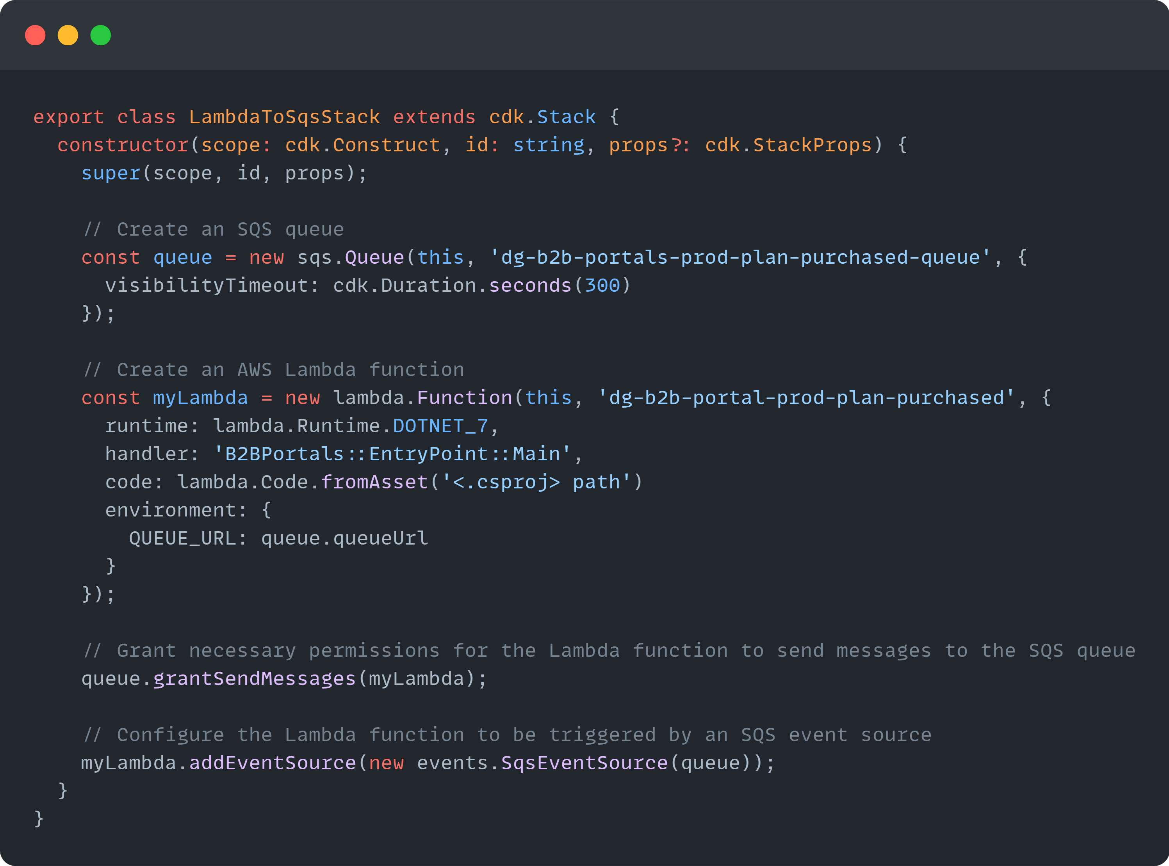
CDK Example: Lambda Function processing SQS messages

Slide 10
CDK Constructs and Stacks
Not native AWS terminology, it is CDK specific terminology
At a high level, constructs are types available in the CDK library for use by developers
Lambda, S3 Bucket, API Gateway are examples of constructs
Stacks are written by developers to define their infrastructure needs
In our project, some examples of stacks could be:
FrontendStack – the React SPA
BackendStack – the .NET Lambdas
ConfigurationStack – the database for our various portals and their products
DashboardStack – the database and dashboard for the team to see how many plans are sold daily, how many errors occur, application performance, etc
The unit of deployment in the AWS CDK is called a stack.
All AWS resources defined within the scope of a stack,
either directly or indirectly, are provisioned as a single unit.
AWS Documentation

Slide 11
IaC & CDK Best Practices
Follow patterns we, as developers, hopefully already follow; modularity, reusability, testing
AWS Docs provide examples of unit testing CDK
Ensure appropriate secrets management
Use IaC to its full capability and don’t use environment variables as that is now a redundant step
Do not be tempted to make “one off” changes to infrastructure through a GUI – if a change is needed then refactor the CDK and deploy it
Implement the AWS Well-Architected guidelines and documentation
Separate stateless and stateful stacks
Have a stack containing databases so that you are free to redeploy your stack containing stateless microservices as often as you like without impact on your database stacks

Slide 12
Workflow combining IaC and CI/CD

Slide 13
Summary
When planning for new or existing infrastructure always create an architecture diagram
Try out changes to infrastructure by creating a PR and GitHub Actions will create a unique environment for you – don’t make “one off” changes in AWS UI
We are using CDK for our IaC needs
CDK has several best practices documented
CDK is comprised of stacks, constructs, and many other types
IaC will allow us to be more agile with tighter feedback loops and faster deployments

